Slide 1
The Data Quality Pre-Processing Tool
Group Project

Slide 2

The User
They work in a nonspecific industry
They work with data, but they have low to medium technical proficiency
They want to simplify data cleaning
They want a tool which can automatically clean their data.
They want a user-friendly interface.
They want a visualization of their data quality
They want real time feedback
They want their data to be secure.

Slide 3
Technical problem
Our system frees users to tackle advanced analytics by handling data cleaning.
Crafting a universal data quality tool is challenging due to the requirements of integrating varied data, ensuring accuracy, real-time monitoring, legal compliance, user-friendly interfaces for all, and scalability, all while meeting organizations' unique needs and standards.
Competing products are outdated and lack the GPT feature for custom data quality rule creation.

Slide 4
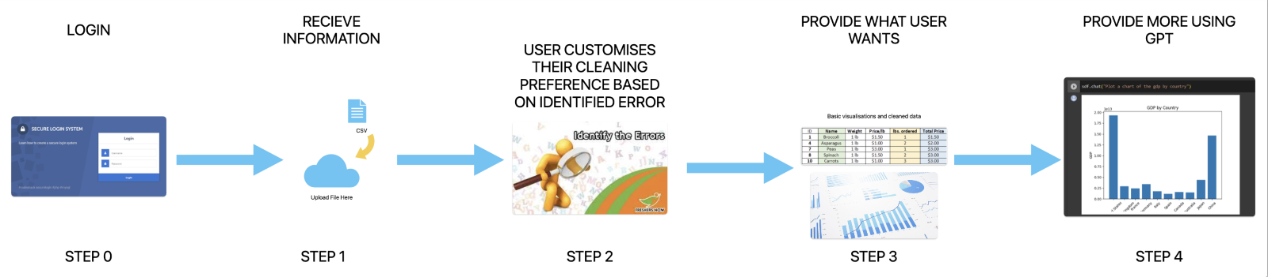
Technical solution
The system ingests data, profiles it to identify issues, and offers users automated correction options. Once cleaned, the data is presented back, and users can query it using the AI feature.

Slide 5
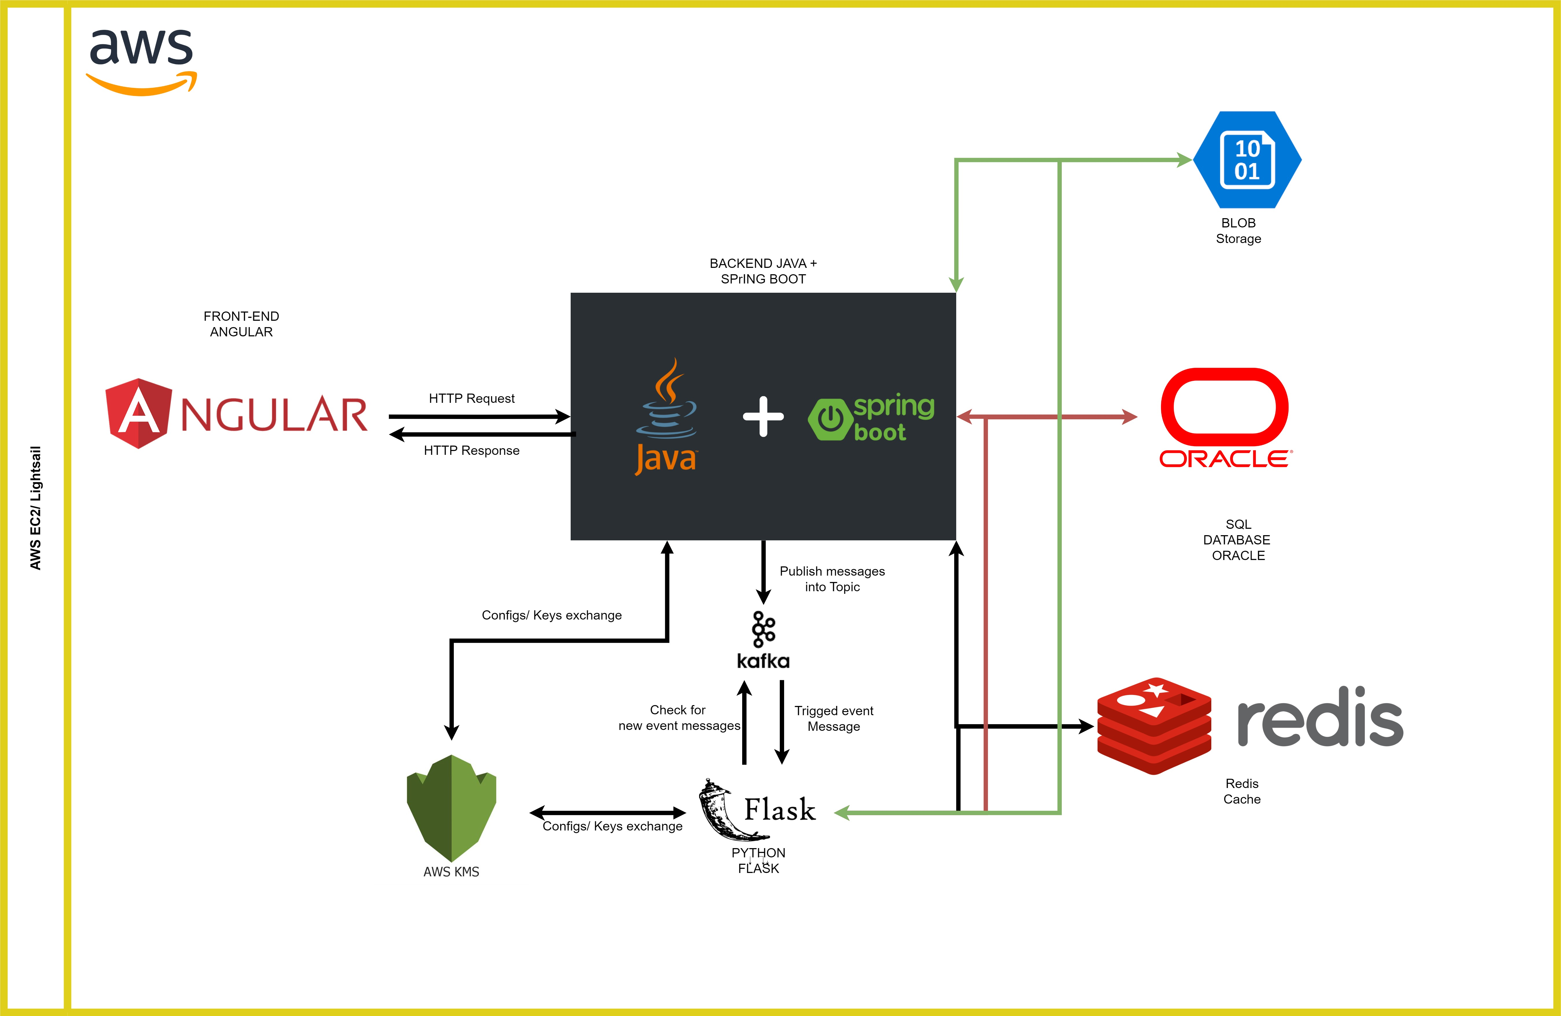
Tech stack

Slide 6
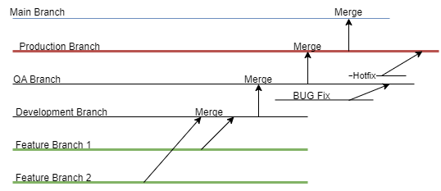
Git Flow

Slide 7
Evaluation
User Feedback: Development considers reviews and suggestions from 20 users to address needs and expectations.
Prototyping & Testing: Wireframes outline application functions, with each release undergoing comprehensive testing, using tools like Postman and UiPath.
Data Quality Assessment: Continuous evaluation of data cleaning algorithms ensures improved data reliability.
Usability Testing: Users evaluate UI and UX to identify and resolve usability issues for intuitive application use.
Performance Monitoring: Key metrics are tracked, and user-reported issues are prioritized for continuous performance improvement

Slide 8
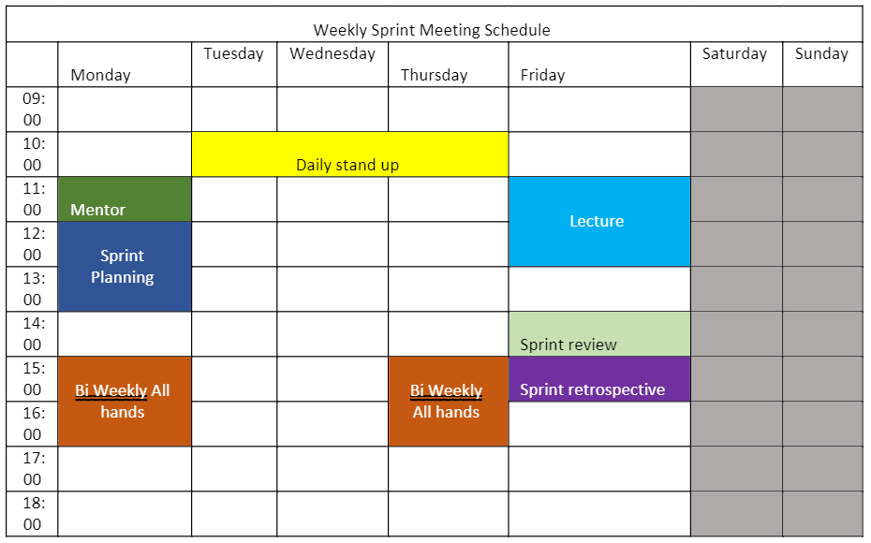
The plan
The project will use the agile methodology

